Slide 1
CSE 325: INFORMATION SYSTEM DESIGN
Week 2: Requirement Analysis Techniques- UML
Novia Nurain
Slide prepared by Anindya Iqbal Sir

Slide 2
What is UML (Unified Modeling Language)?
UML is a standardized visual modeling language used to describe, design, and document software systems.
pictures or views of an OO system
helps better understanding
a picture is worth a thousand words

Slide 3
Why do we need UML?
Understanding system requirements
Designing system architecture
Documenting system functionality
Improving communication between stakeholders:
Complex applications need collaboration and planning from multiple teams and hence require a clear and concise way to communicate amongst them.
Businessmen do not understand code. So UML becomes essential to communicate with non-programmers about essential requirements, functionalities, and processes of the system.
Supporting implementation and testing
Time is saved down the line when teams can visualize processes, user interactions, and the static structure of the system.

Slide 4
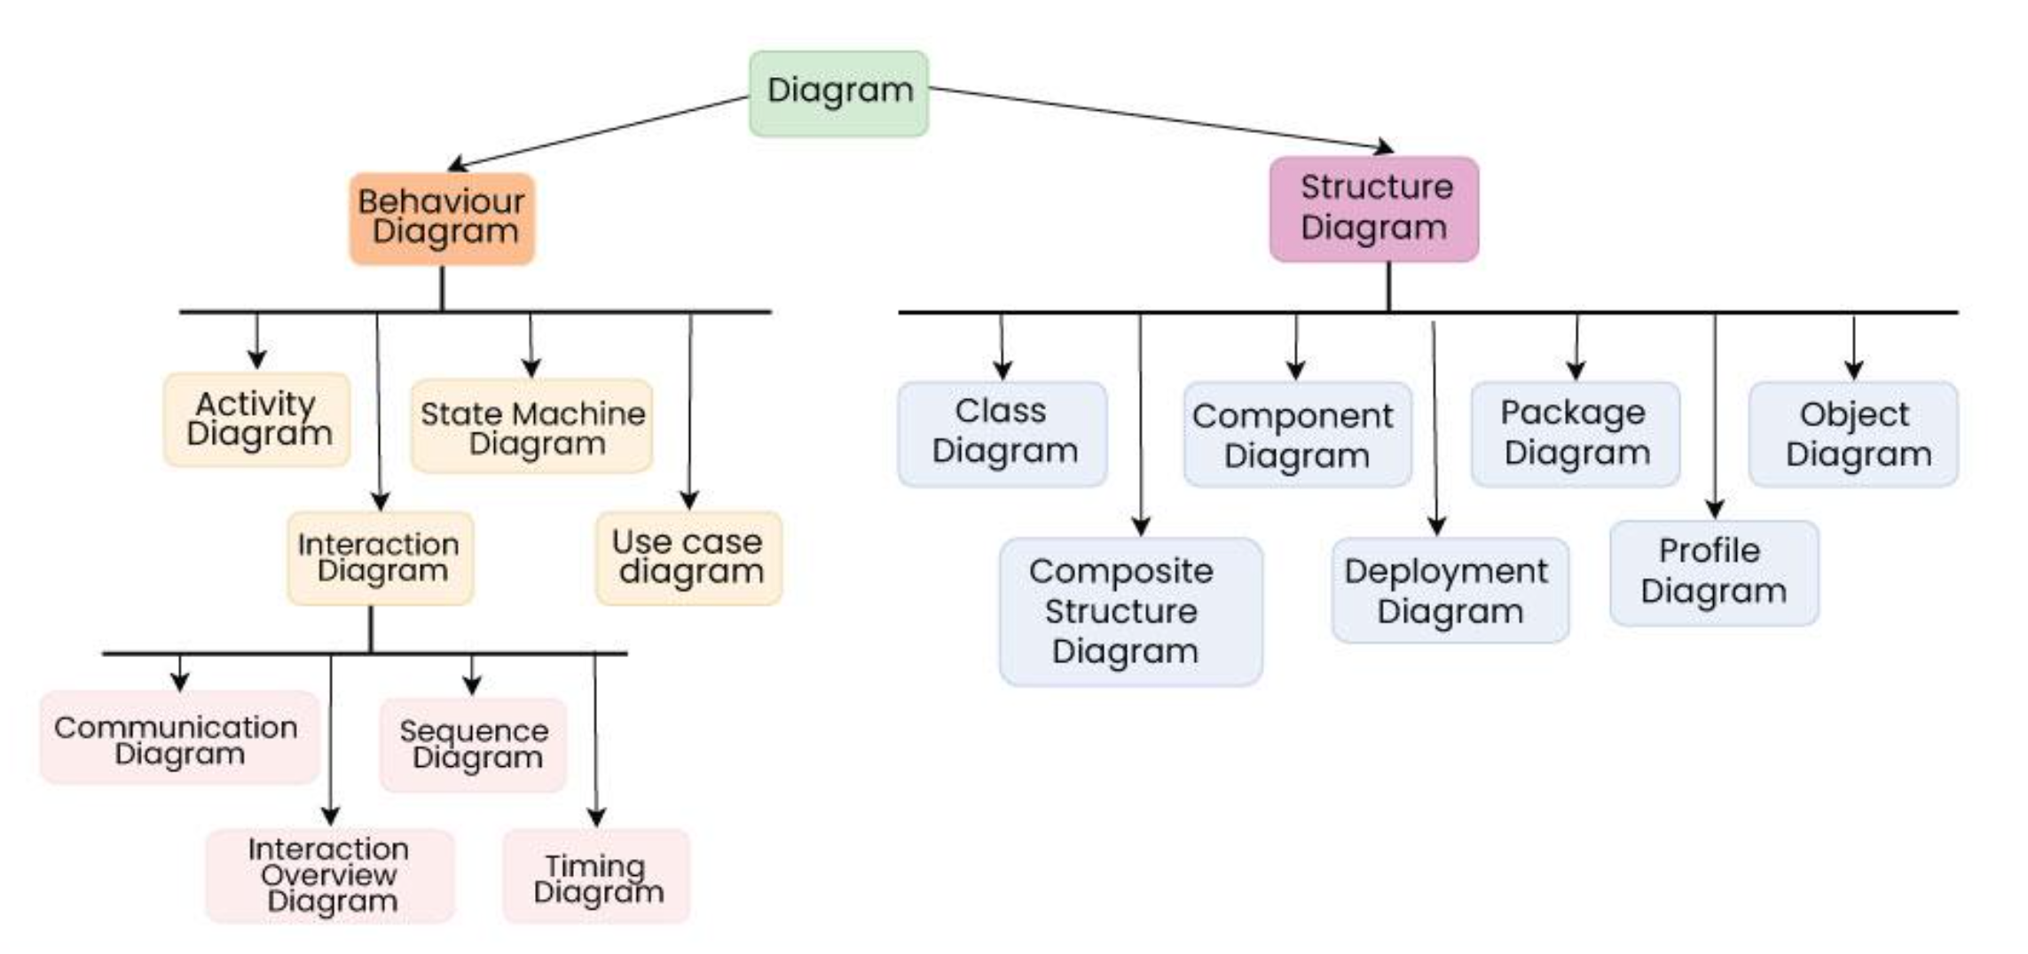
Types of UML diagrams

Slide 5
Types of UML diagrams
depict the static aspects of a system, including its classes, objects, components, and their relationships, providing a clear view of the system's architecture

Slide 6
Types of UML diagrams
depict the dynamic aspects of a system, illustrating how objects interact and behave over time in response to events.

Slide 7
Types of UML diagrams

Slide 8
Use Case Diagrams
Use Case Diagrams are used to depict the functionality of a system or a part of a system. Use case diagrams describe what a system does from the standpoint of an external observer. The emphasis is on what a system does rather than how.
They are widely used to illustrate the functional requirements of the system and its interaction with external agents(actors). Illustrates the activities that are performed by the users of the system.
A use case is basically a diagram representing different scenarios where the system can be used. A formal way of representing how a business system interacts with its environment.
A use case diagram gives us a high-level view of what the system or a part of the system does without going into implementation details.
A sequence of actions a system performs that yields a valuable result for a particular actor.

Slide 9
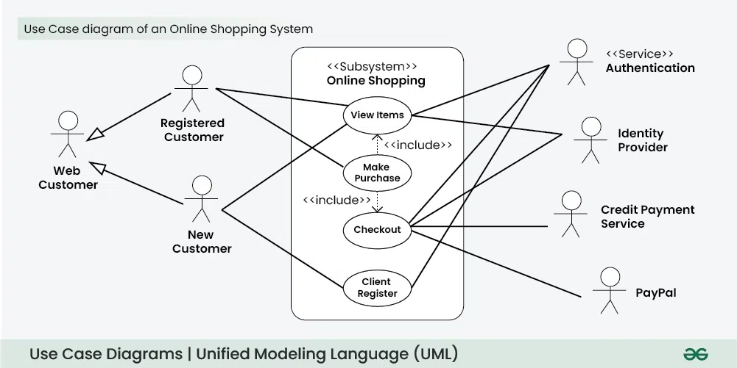
Use Case Diagrams
Online tool for drawing use case diagram: https://www.lucidchart.com/pages

Slide 10
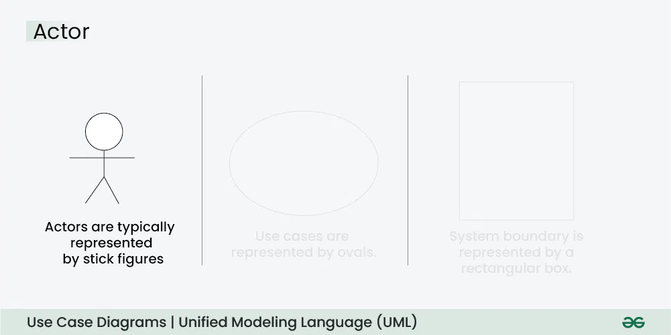
Use Case Diagrams
Online tool for drawing use case diagram: https://www.lucidchart.com/pages

Slide 11
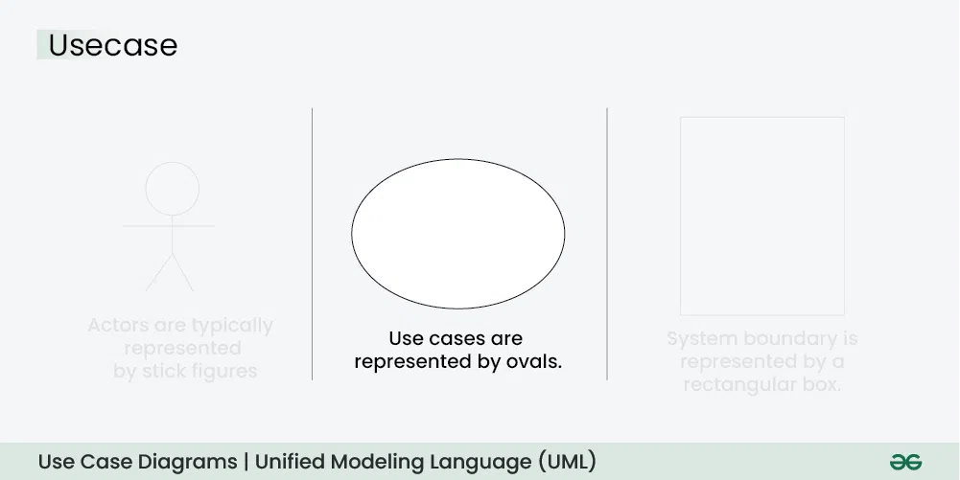
Use Case Diagrams
Online tool for drawing use case diagram: https://www.lucidchart.com/pages

Slide 12
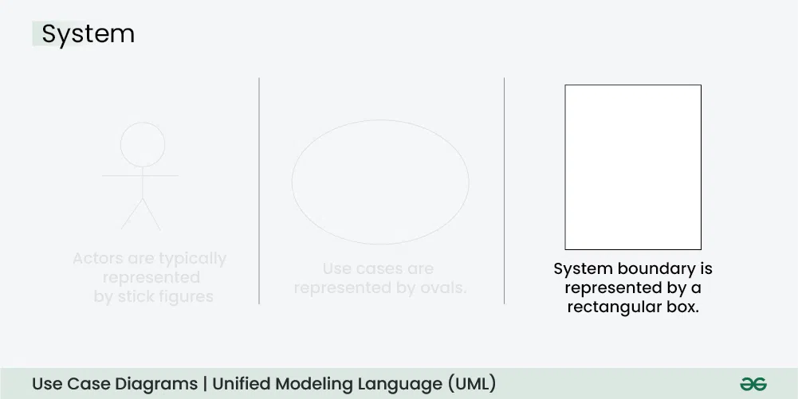
Use Case Diagrams
Online tool for drawing use case diagram: https://www.lucidchart.com/pages

Slide 13
Actors
An Actor is outside or external the system.
It can be a:
Human
Peripheral device (hardware)
External system or subsystem
Time or time-based event
Represented by stick figure with name below
Patient
Notes:
Actors
Are NOT a part of the system (external to the system)
A single actor may represent multiple physical users
Whether human or not, represented by stick figure
MUST label stick figure with the name of the actor
Primary actors should be left and secondary actors to the right

Slide 14
Actors and stakeholders
What is an actor? A primary actor?
What is the difference between an actor and a stakeholder?
actor: anything (people, other systems, devices, time) outside the system that interacts with it to achieve a goal, with behavior that acts on the system
primary actor: initiates direct interaction to achieve a goal (when system is a software product, primary actor is often the computer user)
supporting actor: performs sub-goals to help use case, provides services to the system but doesn't initiate the primary goal
stakeholder: anyone interested in the system
examples: supplier, stock agency, vendor
the difference: stakeholder might not "act" in any scenario

Slide 15
Key Characteristics of Actors
External Entity: Always outside the system boundary, not the system itself.
Role-Based: Represents a role, not a specific person (e.g., "Customer," not "John Doe").
Initiator/Responder: Initiates a use case (primary) or provides services to the system (secondary).
Types: Can be humans (User), external systems (API, Database), or even time/events (Timer).

Slide 16
How to identify actors?
Who is interested in the scenario/system?
Where in the organization is the scenario/system be used?
Who will benefit from the use of the scenario/system?
Who will supply the scenario/system with this information, use this information, and remove this information?
Does one person play several different roles?
Do several people play the same role?
Notes:
Actors
7) Does one person play several different roles?
May have an actor for each role
8) Do several people play the same role?
Only use one actor per role (no matter how many people play that role)
Identifying actors is an iterative process
Defining how an actor interacts with the system may clarify whether there are duplicate actors or not

Slide 17
Use Cases
Each use case in a use case diagram describes one and only one function in which users interact with the system
May contain several “paths” that a user can take while interacting with the system
Each path is referred to as a scenario
Represents an activity of an actor
Use cases as ellipses with their names below or inside
Make appointment
Actors are stick figures. Use cases are ovals. Communications are lines that link actors to use cases.

Slide 18
Use Case - Relationships
Relationships
Represent communication between actor and use case
Depicted by line or double-headed arrow line
Also called association relationship
Make
Appointment
Make appointment
Patient

Slide 19
Use Case - Relationships
Boundary
A boundary rectangle is placed around the perimeter of the system to show how the actors communicate with the system.
Make
Appointment
Patient
Notes:
System boundary: A system boundary defines the scope of what a system will be. A system cannot have infinite functionality. So, it follows that use cases also need to have definitive limits defined. A system boundary of a use case diagram defines the limits of the system. The system boundary is shown as a rectangle spanning all the use cases in the system.
Other use cases in this lecture also show the system boundary of the clinic application. The use cases of this system are enclosed in a rectangle. Note that the actors in the system are outside the system boundary.
The system boundary is potentially the entire system as defined in the problem statement. But this is not always the case. For large and complex systems, each of the modules may be the system boundary. For example, for an ERP system for an organization, each of the modules such as personnel, payroll, accounting, and so forth, can form the system boundary for use cases specific to each of these business functions. The entire system can span all of these modules depicting the overall system boundary.

Slide 20
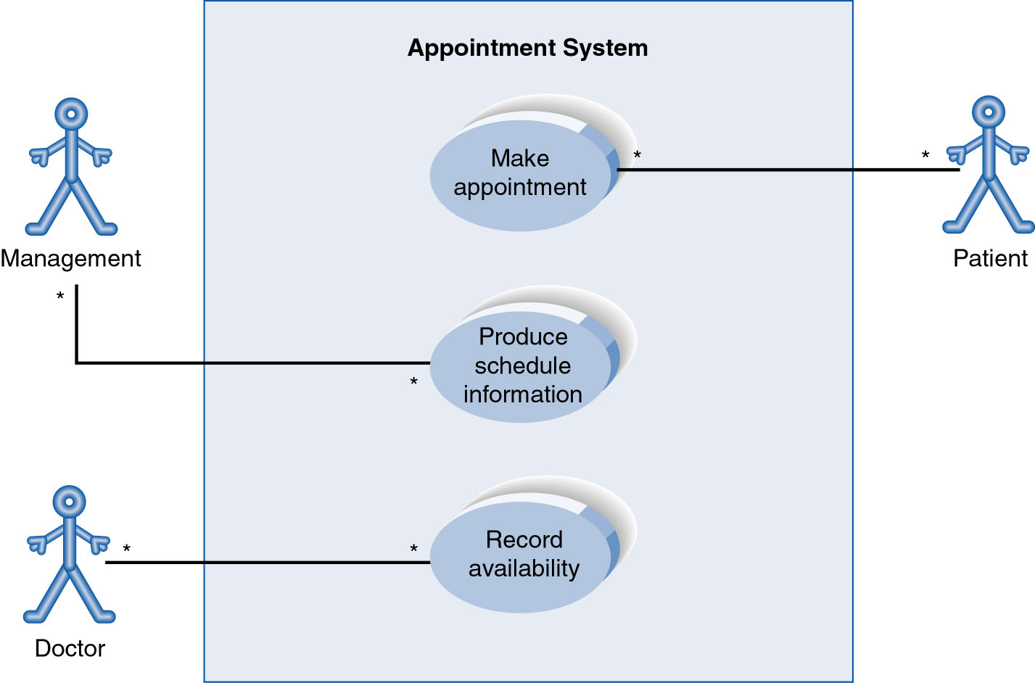
Sample use case diagram: Hospital

Slide 21
Use Case relationship: Generalization
Generalization
From child to parent
Represented by a line and a hollow arrow
Patient
New Patient
Old Patient
Notes:
Inheritance

Slide 22
Use case relationships: Extend
Extend
Represents the extension of the use case to include optional functionality
Arrow is drawn from the extension use case to the base use case
Write << extend >> above arrowhead line
<<extend>>
Update patient information
Make appointment

Slide 23
Use case relationship: Include
Include
Represents the inclusion of the functionality of one use case within another
Arrow is drawn from the base use case to the used use case
Write << include >> above arrowhead line
<<include>>
Record availability
Manage schedule

Slide 24
Remember
Use case diagrams represent users’ goals (functional goals)
Not technical prerequisite, conditions, or requirements.

Slide 25
UML editors
Rational Rose (commercial): http://www-03.ibm.com/software/products/en/ratirosefami
ArgoUML: http://argouml.tigris.org/
Violet: http://alexdp.free.fr/violetumleditor/page.php
Visual Pardigm (commercial): http://www.visual-paradigm.com/solution/freeumltool/
StarUML: http://staruml.io/
UMLet: http://www.umlet.com/

Slide 26
Practice
Hotel room booking system: Rachel browses hotels online. She logs in, searches for hotels by date and location, and books a room. Booking includes selecting the room type and payment. She can optionally request special amenities.
Banking system: John logs into his online banking account. He can view balance, transfer money, or pay bills. Transferring money always includes authentication. Paying bills can optionally include scheduling recurring payments.

